Slide 1
Nubes Lacus
Cloud based data lakes for Data Science operations

Slide 2
What’s this about
Brief overview on Data Science operations.
How data sources fit in to Data Science.
Roles and Interactions.
Data Science perspective of cloud tools for
Data processing
Data Storage
Application Servicing
Being an all around cool person.

Slide 3
What this is not
System / Enterprise / Security Architecture.
Machine Learning lecture.
GCP Deep dive.
Solution to every problem you
Have had.
Are having.
Will have.

Slide 4
Hopeful takeaways
Inspire democratization of your Data Science team.
Inspire Data Science Collaboration.
Inspire Value driven Data Science.
Not bore you while you eat your lunch.
Apologies in advance for the number of slides.

Slide 5
How this is laid out
Fictional financial institution
1
Business Objective
2
Reduce fraud without a 100 point id check.
Data Scientist value proposition
3
Flag fraudulent transactions more accurately.
Reduce the time to action.
Developing a data product
4
Consumption

Slide 6
Data Science in business
Data Science usually plays two roles :
Investigative / Research.
Value Driven.
Data Science teams play many roles:
Analytics lifecycle.
Reporting.
Root cause analysis.
Data Engineering
Etc…

Slide 7
Investigative Data Science
Very similar to classical Analytics lifecycle.
Usually domain knowledge dominates.
Knowledge is very team centric.
Generates insights, answers domain questions, etc.
Sort of like an optimisation problem.

Slide 8
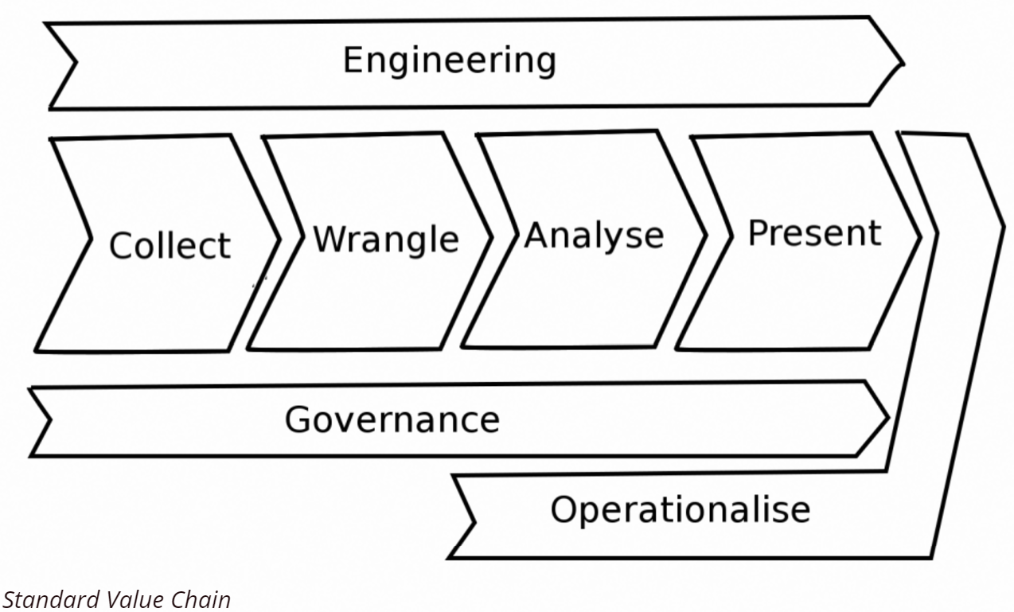
Value driven Data Science
Very similar to Software development.
Technical skills dominate.
Domain agnostic.
Generates products, or more generally consumables.
Sort of like a constraint satisfaction / BV problem.

Slide 9
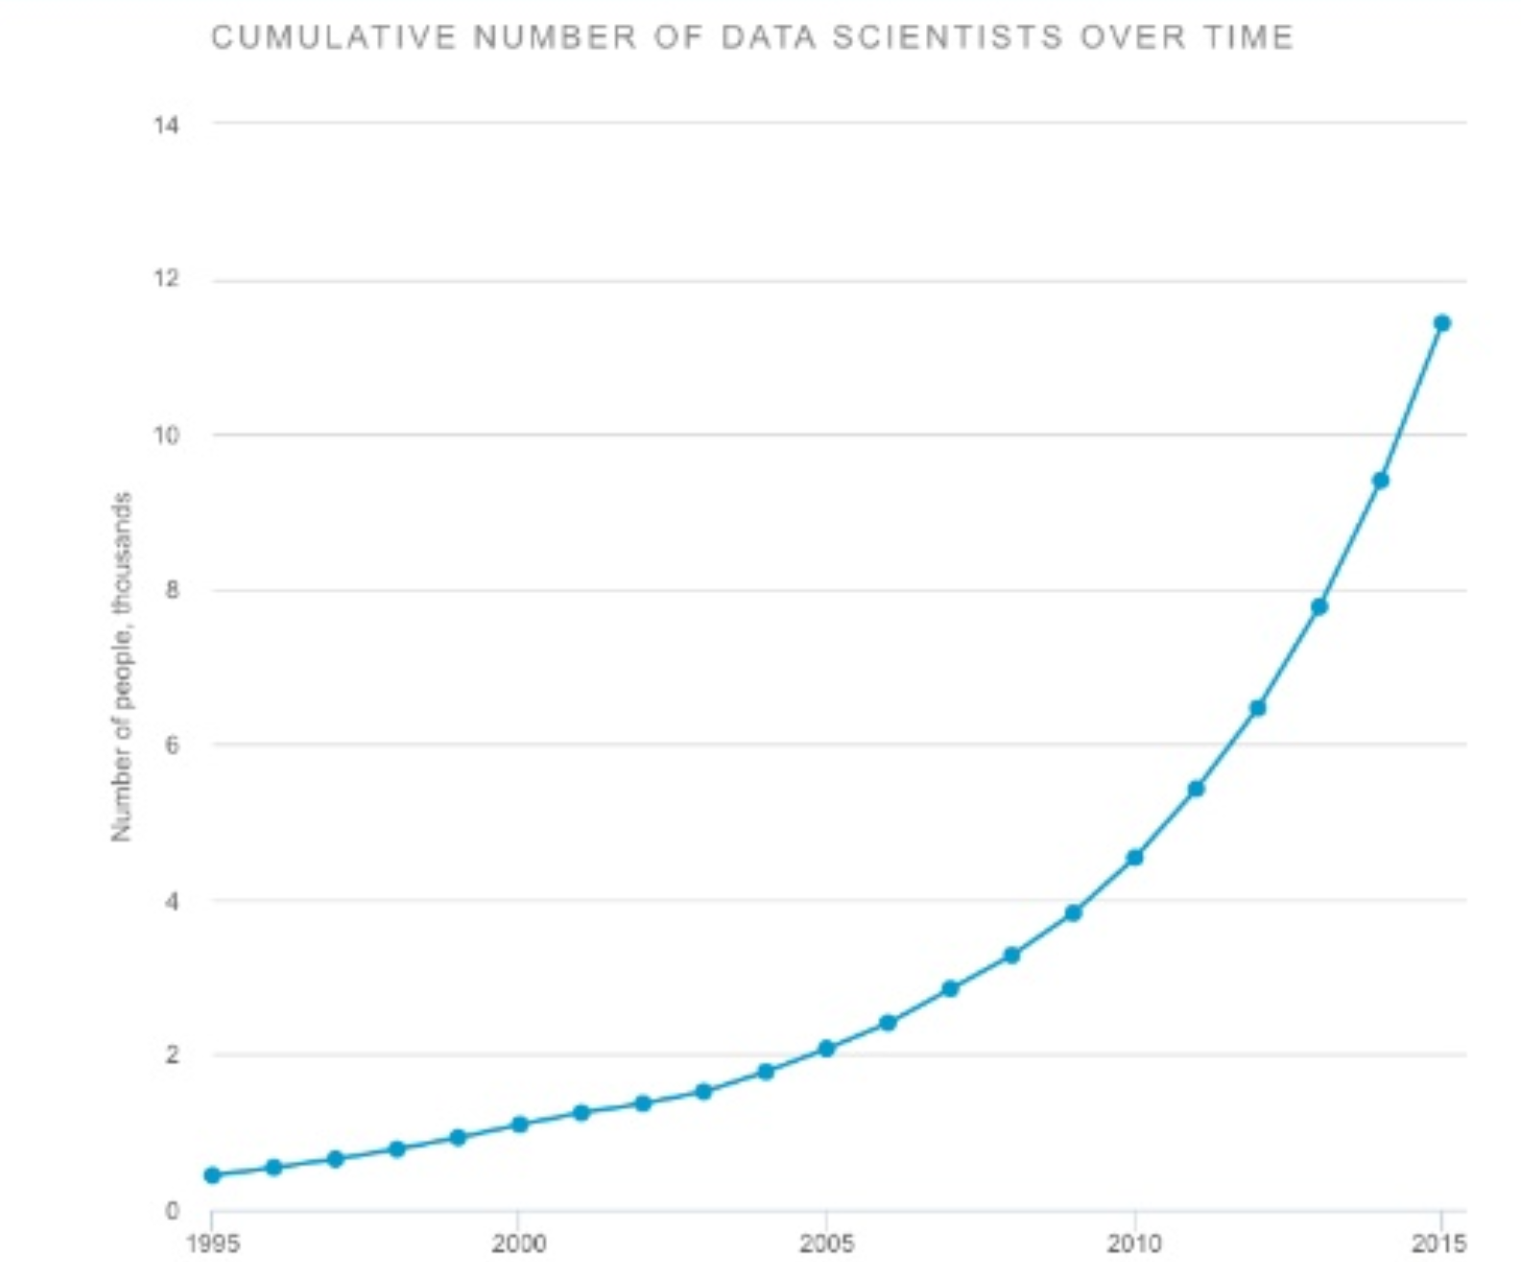
Data
Data Science exists because of everyone but data scientists.
Data only needs two roles to be useful
Generators
Consumers
So Data Science ops should focus on
Gathering from Generators
Providing to Consumers
Why is this relevant?
Solutions should be tailored to the problem
Not to the delivery team.

Slide 10
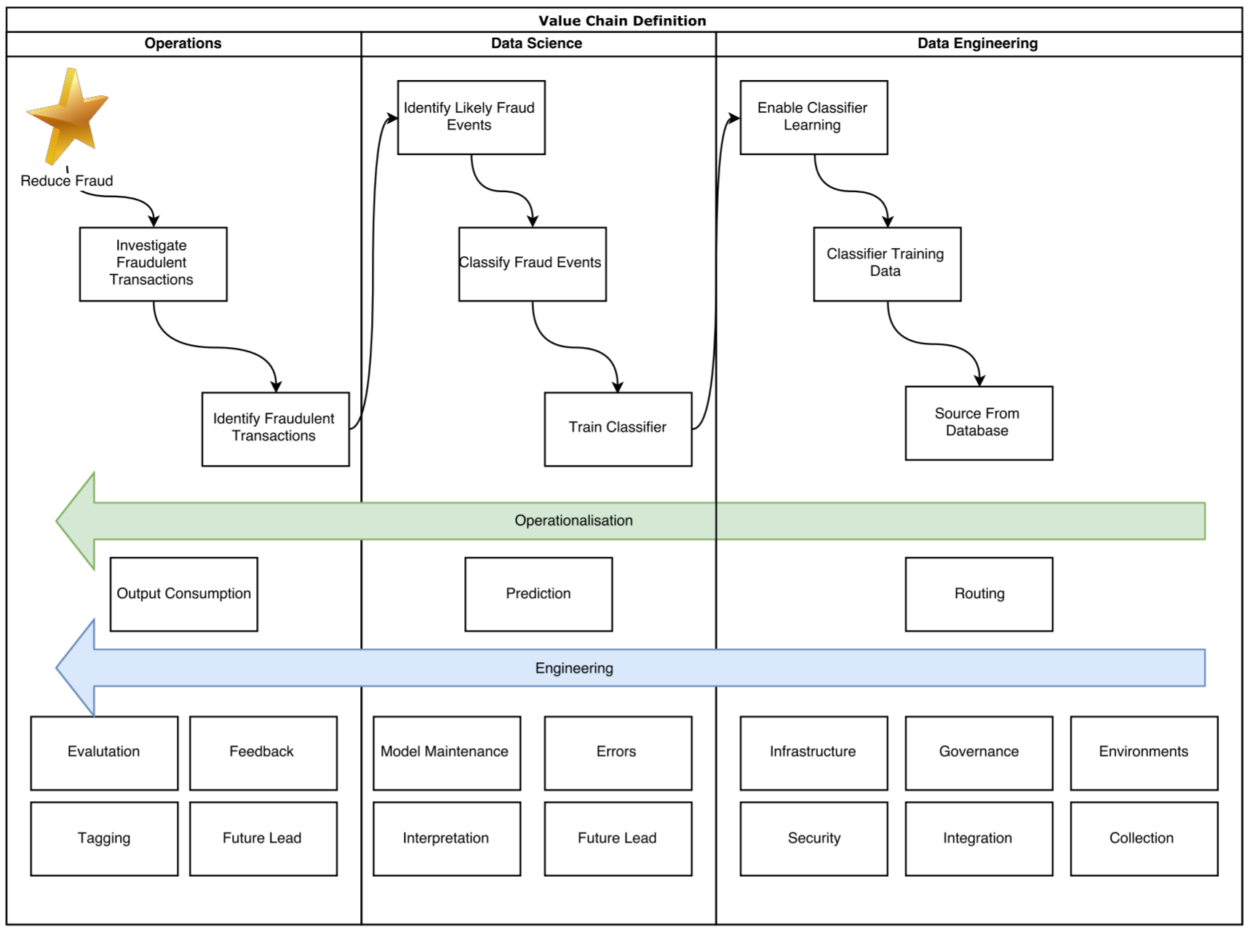
Defining Our Value Chain
Very simple view of a value chain definition.
Should be much more expanded in a real situation.
Acceptance criteria should be defined for each block.

Slide 11
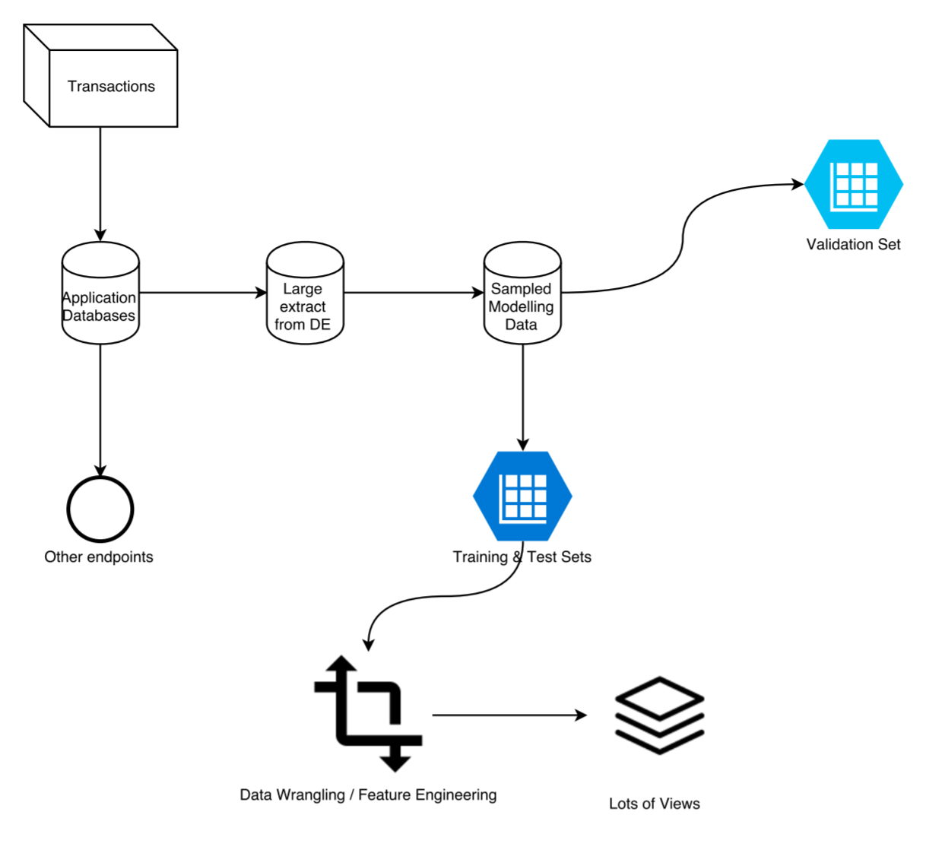
Training Architecture

Slide 12
Provisioning the data
Skipping a step here of initial drop.
Locate dataset in a central object storage.
Set up views on our data.
Why?
SQL Oriented querying.
Keep simple statistics over in the cloud.
Everyone loves SQL.
Demo: GCP BigQuery

Slide 13
Data Transformations
Setup basic feature data wrangling tasks.
Maybe create multiple big query tables (perhaps with iterations).
Demo GCP DataPrep.

Slide 14
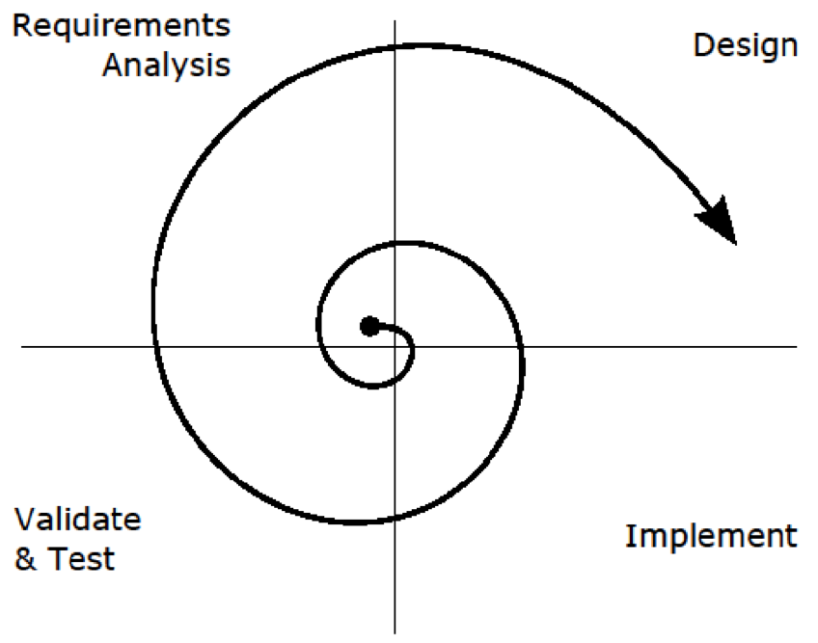
Modelling
Usually a very iterative process.
Further feature engineering, tweaking, sampling may occur.
Cloud DataPrep and BigQuery tables can play a significant role here.

Slide 15
Operationalisation
Developing good models is hard. Operationalising them is even harder.
Main areas of problems
Ingestion.
Consumption.
Maintenance.

Slide 16
Ingestion
We need to move operational data to the predictor space.
Apply any transformations.
Data standardisations and validations.
Feature generations (transforms).
Normalisations (centering / scaling).
Batching / Pooling
Row-wise dependence.

Slide 17
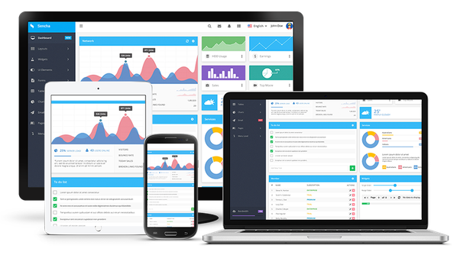
Consumption
How is it consumed?
Web page, ticket generator, API, Mobile Service
Integrating with other products ? Required specifications.
Metadata management and collation.
Response from implementations and services.

Slide 18
Maintenance
Keep it relevant to what the initial value proposition
Get feedback from the consumers to its performance
Test and update the model as its performance changes

Slide 19
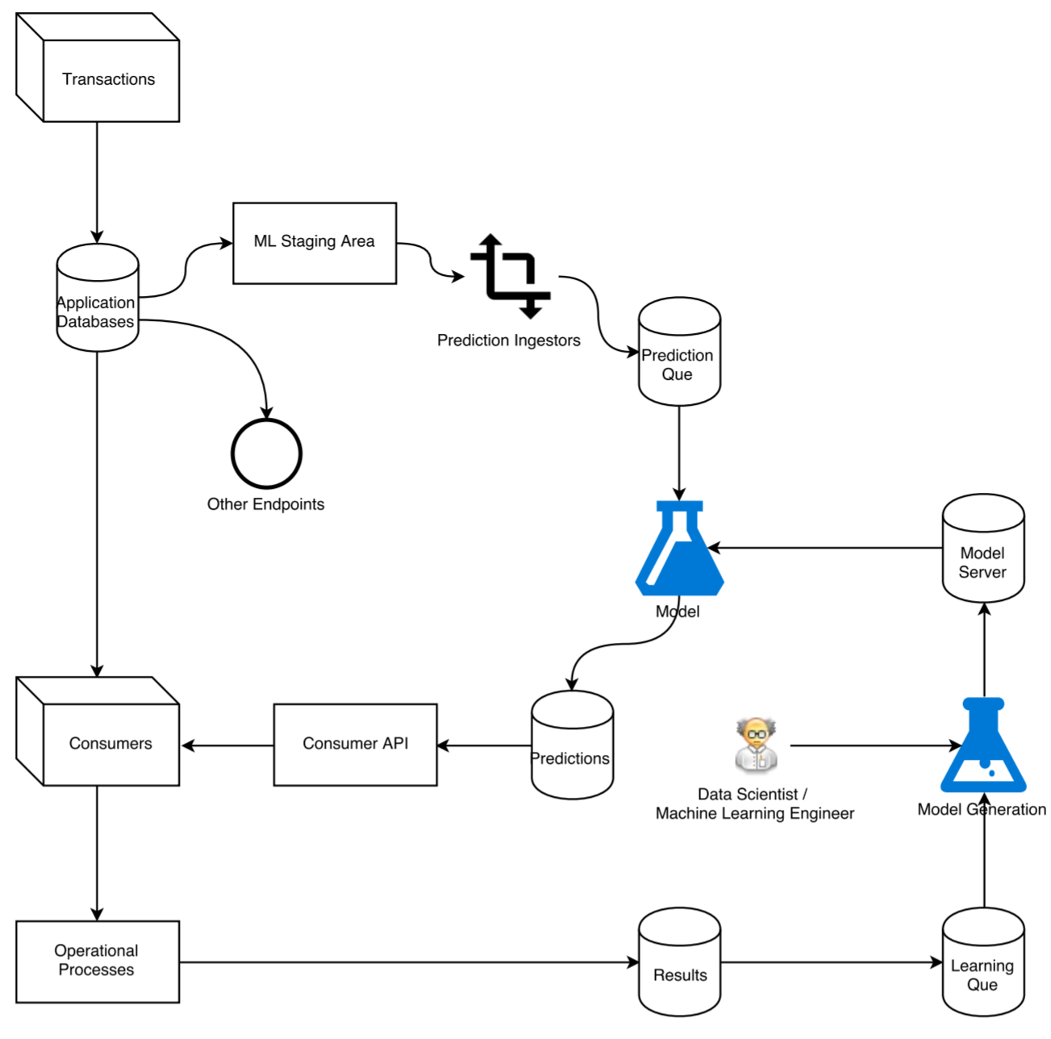
Operationalised architecture

Slide 20
What’s your point?
Value chaining Data Science projects with products can help.
Best model always loses to the best implemented model.
Operationalisation should be considered at definition not after development.
Lot’s of moving parts, so abstraction is your friend.

Slide 21

Thank You

